Slide 1
Generative AI for Engineering
Final Project
Submitted by:
V.Sivacharan
813821104095

Slide 2
PROJECT TITLE
Image Generation and Discrimination using GAN Model

Slide 3


AGENDA
Problem Identification
Resource gathering
Develop Model
Model Training
Develop Discriminator
Discriminator Training
Generate Images
3/21/2024 Annual Review

Slide 4

PROBLEM STATEMENT
To develop and train a GAN Model to perform Image Generation using CIFAR10 dataset as a source

Slide 5
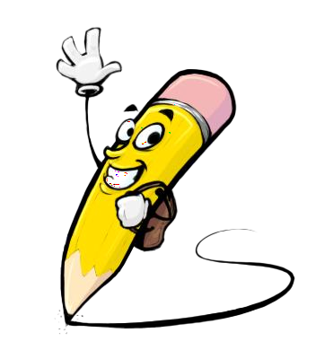
PROJECT OVERVIEW
This project focuses on generating CIFAR-10-like images using Generative Adversarial Networks (GANs). The custom GAN model consists of a Generator and a Discriminator, trained to produce realistic images and differentiate between real and generated ones.
After training, we use the trained model to generate new images.
We can experiment with different latent space values to explore image variations.

Slide 6

WHO ARE THE END USERS?
Graphic Designers
Digital Artists
Photographers
Content Creators
Educators
Small Business Owners
Marketing Professionals
UI/UX Designers
Artificial Intelligence Researchers
Hobbyists

Slide 7

YOUR SOLUTION AND ITS VALUE PROPOSITION
We train a custom GAN model on the CIFAR-10 dataset.
The GAN Model generates images resembling CIFAR-10 images with unique variations.
This model can be used for
Data Augmentation: Augment existing datasets with synthetic images.
Concept Exploration: Explore novel concepts and artistic expressions.
Prototyping: Create mock-ups and test interfaces with generated images.
Trained to differentiate between real images and generated ones

Slide 8

THE WOW IN YOUR SOLUTION
Photo-Realistic Results: GANs can generate images that closely resemble real photographs in terms of details, textures, and colors. The ability to create such high-fidelity images can often be surprising and impressive to users.
Creative Exploration: GANs enable users to explore a vast space of possible images, allowing for the generation of novel and imaginative visuals. Users can experiment with different input parameters or styles to produce diverse and unexpected results.
Style Transfer and Fusion: GANs can learn and transfer artistic styles from one image to another, leading to the creation of unique and visually striking compositions. This ability to blend and merge different visual elements can produce aesthetically pleasing and captivating imagery.
Interactive Interfaces: Interactive interfaces that allow users to manipulate various aspects of the image generation process in real time can create a sense of engagement and wonder. Users can actively participate in shaping the output, leading to a more immersive experience.
Large-Scale Synthesis: GANs can generate images at high resolutions and scale, producing detailed and complex scenes that capture intricate patterns and structures. The ability to generate large-scale images adds to the realism and impact of the generated visuals.
.
3/21/2024 Annual Review

Slide 9
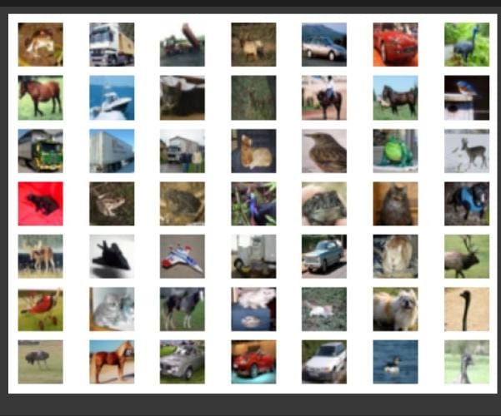
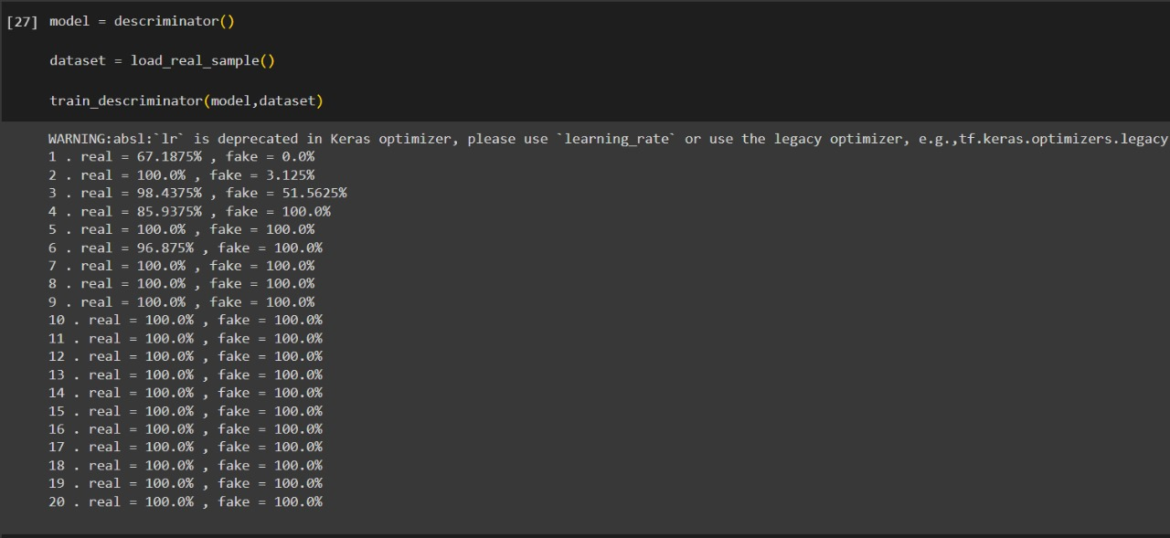
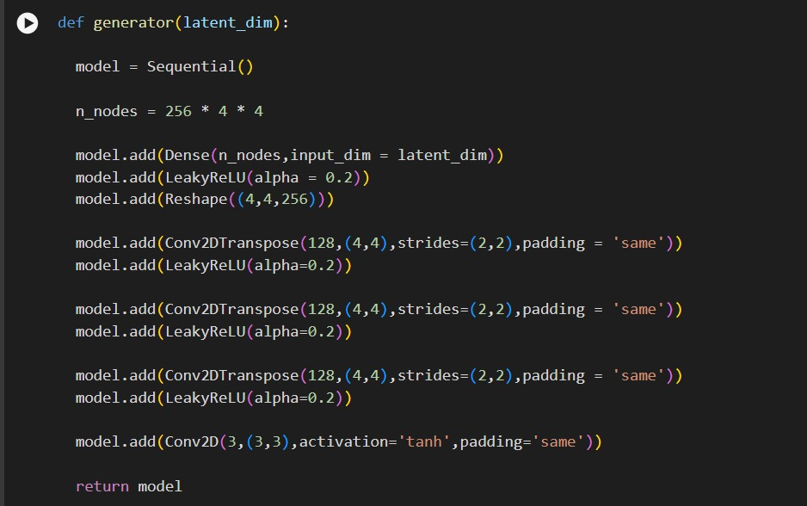
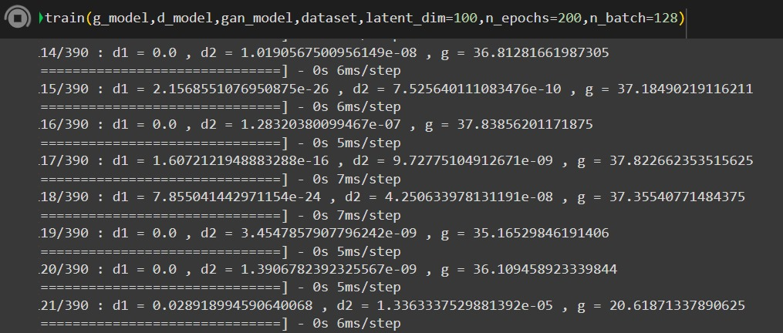
MODELLING
CIFAR10 IMAGE DATASET
DICRIMINATOR
TRAINING
GENERATOR

Slide 10
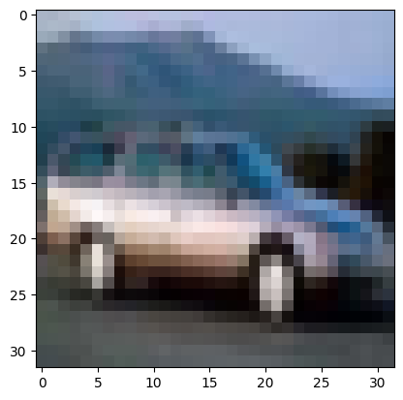
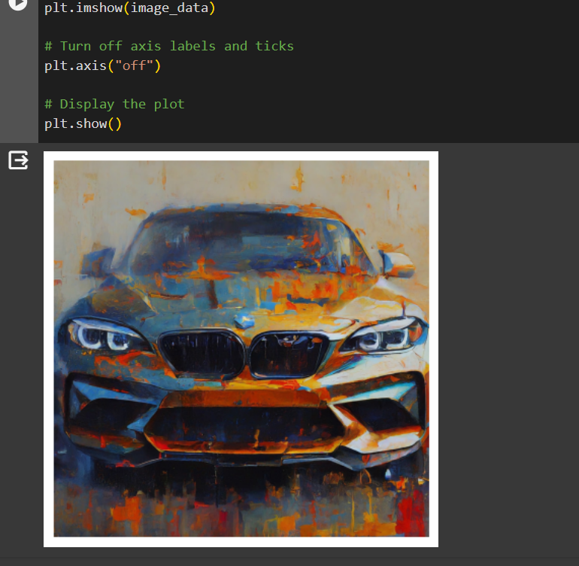
RESULTS
The Image Generation for a simple prompt “CAR” on a GAN Model trained on CIFAR-10 Dataset yield:
demo link

